Slide 1



Slide 2

“PARTIAL DIFFERENTIAL EQUATION”
Presentation on

Slide 3

Introduction
Partial Differential Equation
Partial Differential Equations (PDEs) are mathematical equations involving partial derivatives of an unknown function with respect to two or more independent variables.
PDEs are widely used to describe and analyze physical, engineering, and mathematical phenomena where quantities depend on several variables.

Slide 4

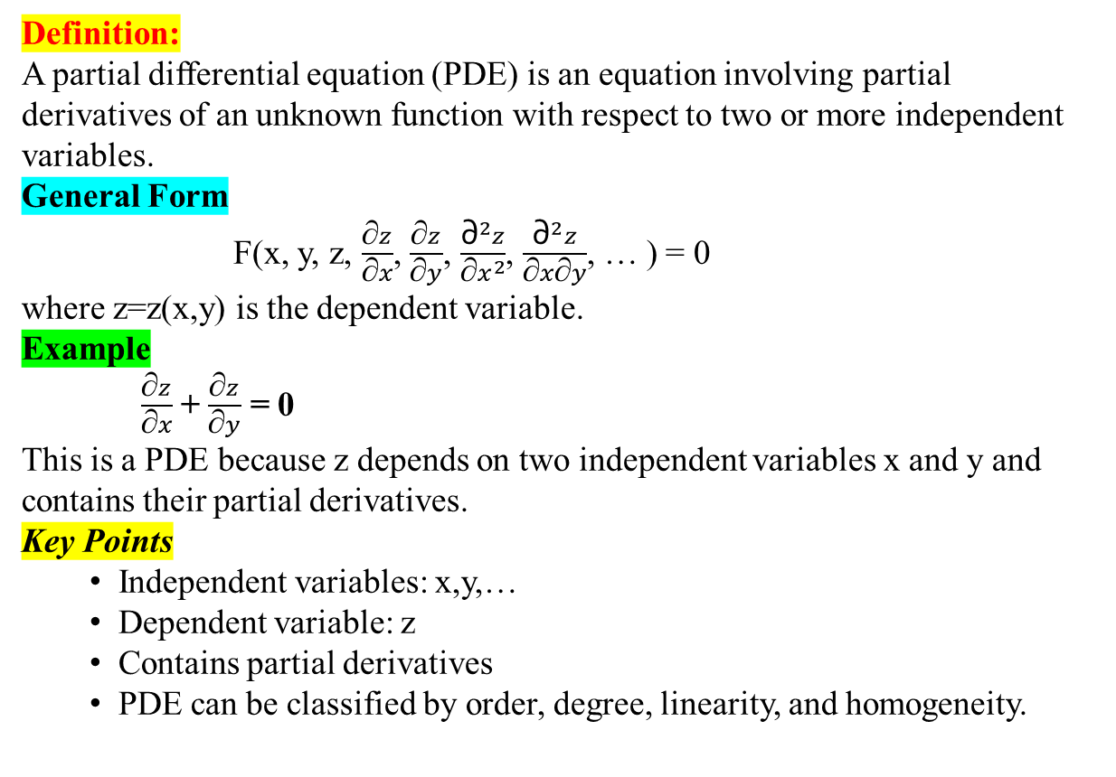
Partial Differential Equation (PDE)
PART 04
Definition:
A partial differential equation (PDE) is an equation involving partial derivatives of an unknown function with respect to two or more independent variables.
General Form
F(x, y, z, $\frac{\text{∂}z}{\text{∂}x}$​, $\frac{\text{∂}z}{\text{∂}y}$​, $\frac{{\text{∂}}^{2}z}{\text{∂}x^{2}}$​, $\frac{{\text{∂}}^{2}z}{\text{∂}x\text{∂}y}$​, … ) = 0
where z=z(x,y) is the dependent variable.
Example
$\frac{\text{∂}z}{\text{∂}x}$ + $\frac{\text{∂}z}{\text{∂}y}$ = 0
This is a PDE because z depends on two independent variables x and y and contains their partial derivatives.
Key Points
Independent variables: x,y,…
Dependent variable: z
Contains partial derivatives
PDE can be classified by order, degree, linearity, and homogeneity.
PART 03
PART 01
PART 02

Slide 5

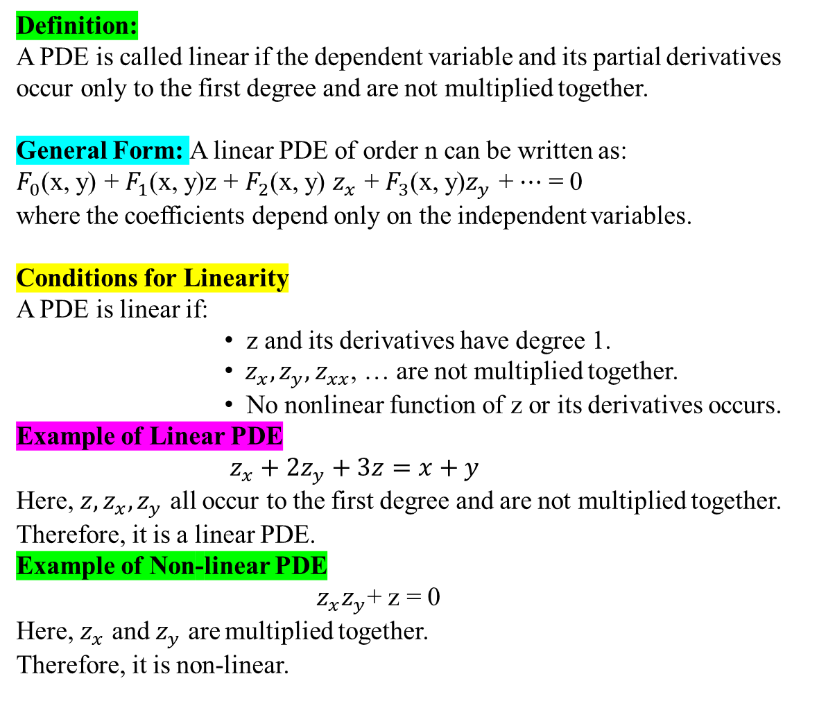
Linearity of Partial Differential Equation
Definition:
A PDE is called linear if the dependent variable and its partial derivatives occur only to the first degree and are not multiplied together.
General Form: A linear PDE of order n can be written as:
$F_{0}$​(x, y) + $F_{1}$​(x, y)z + $F_{2}$​(x, y) $z_{x}$ ​+ $F_{3}$​(x, y)$z_{y}$​ + ⋯ = 0
where the coefficients depend only on the independent variables.
Conditions for Linearity
A PDE is linear if:
z and its derivatives have degree 1.
$z_{x}​, z_{y}​, z_{xx}$​, … are not multiplied together.
No nonlinear function of z or its derivatives occurs.
Example of Linear PDE
$${ z}_{x}​+2z_{y}+3z=x+y$$
Here, $z, z_{x}​, z_{y}$​ all occur to the first degree and are not multiplied together.
Therefore, it is a linear PDE.
Example of Non-linear PDE
$z_{x}​z_{y}$​+ z = 0
Here, $z_{x}$​ and$z_{y}$​ are multiplied together.
Therefore, it is non-linear.
PART 04
PART 03
PART 01
Key Point:
First degree + no product of dependent variables/derivatives = Linear PDE
PART 02

Slide 6


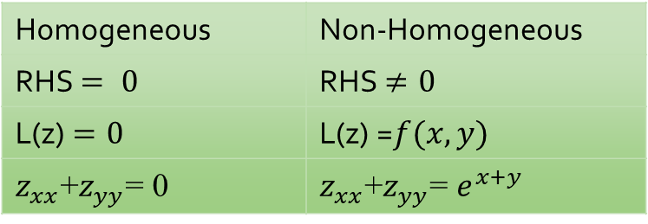
Homogeneous and Non-Homogeneous PDE
PART 04
Homogeneous PDE
De$f^{n}$: Every terms of given model must exist dependent variable.
L(z) = 0​ ;where L is a linear differential operator.
Example:
$z_{xx}​$+$z_{yy}$​= 0
Non-Homogeneous PDE
A linear PDE is called non-homogeneous if it can be written as
$L(z)=f(x,y), f(x,y)≠0$​
Example:
$z_{xx}​$+$z_{yy}$​= $e^{x+y}$
Note: Homogeneous/non-homogeneous classification applies here to a linear PDE.
PART 03
PART 01
Difference
Homogeneous | Non-Homogeneous
RHS $= 0$ | RHS $≠0$
L(z) $=0$ | L(z) =$f(x,y)$
$z_{xx}​$+$z_{yy}$​= 0 | $z_{xx}​$+$z_{yy}$​= $e^{x+y}$
PART 02

Slide 7
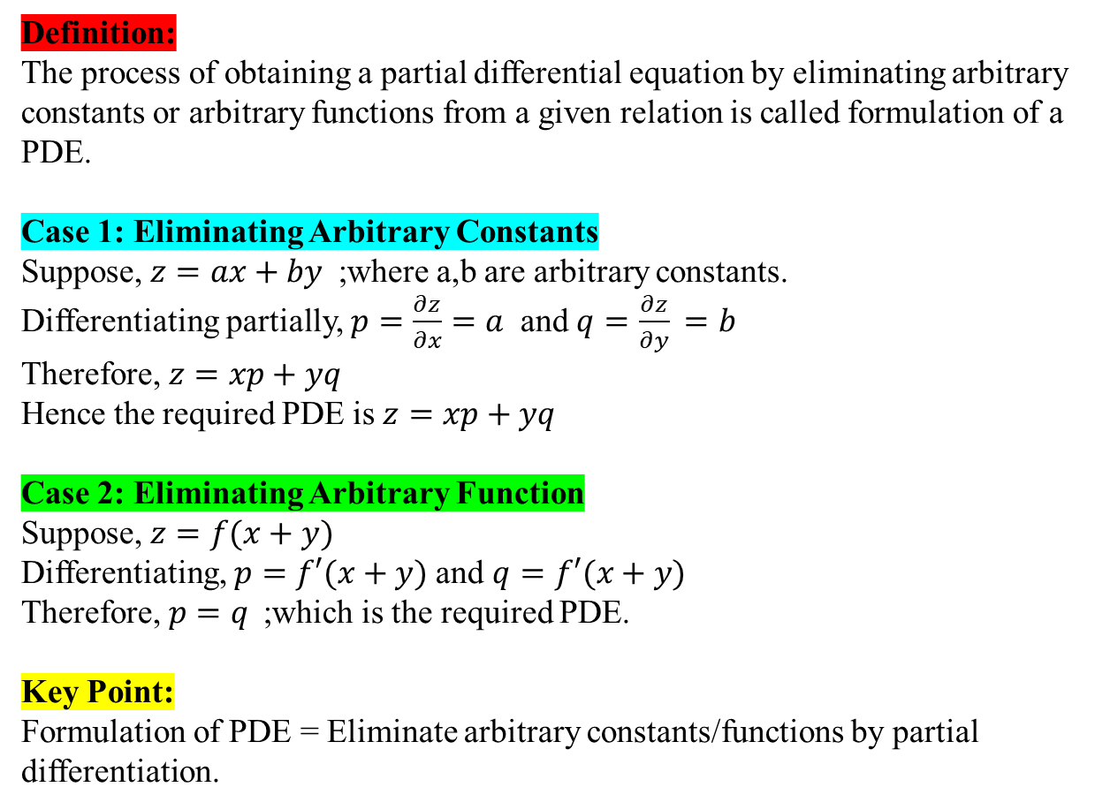
Formulation of Partial Differential Equation
PART 04
Definition:
The process of obtaining a partial differential equation by eliminating arbitrary constants or arbitrary functions from a given relation is called formulation of a PDE.
Case 1: Eliminating Arbitrary Constants
Suppose, $z=ax+by$;where a,b are arbitrary constants.
Differentiating partially, $p=\frac{∂z}{∂x​}=a$ and $q=\frac{∂z}{∂y}​=b$
Therefore, $z=xp+yq$
Hence the required PDE is $z=xp+yq​$
Case 2: Eliminating Arbitrary Function
Suppose, $z=f(x+y)$
Differentiating, $p=f′(x+y)$and $q=f′(x+y)$
Therefore, $p=q​$;which is the required PDE.
Key Point:
Formulation of PDE = Eliminate arbitrary constants/functions by partial differentiation.
PART 03
PART 01
PART 02

Slide 8


First-Order Linear PDE
PART 07
$Def^{n}:$A first-order linear PDE is a PDE involving only first-order partial derivatives of the dependent variable and occurring linearly.
Standard Form
$Pp+Qq=R$where $p=\frac{∂z}{∂x}​,q=\frac{∂z​ }{∂y}$
and P,Q,R are functions of x,y,z.
Lagrange's Linear PDE
The standard equation $Pp+Qq=R$is called Lagrange's linear PDE.
Its auxiliary equations are $\frac{dx}{P}​=\frac{dy}{Q}​=\frac{dz}{R}$​​
From these auxiliary equations, two independent integrals are obtained:
$u(x,y,z)=C_{1}$​ & $v(x,y,z)=C_{2}​$
Hence the complete solution is $φ(u,v)=0​$
Example: $yp+xq=z$
Here, $P=y,Q=x,R=z$
Therefore, $\frac{dx}{P}​=\frac{dy}{Q}​=\frac{dz}{R}$​​
This is a first-order linear PDE.
PART 06
PART 08
PART 05

Slide 9



Non-Linear Partial Differential Equation
PART 08
Definition:
A PDE is called non-linear if the dependent variable or its partial derivatives occur nonlinearly, such as with powers, products, or nonlinear functions.
A PDE is non-linear when it contains:
Powers such as $p^{2},;q^{2},;z^{2}$
Products such as $pq,;zp$
Nonlinear functions such as $sinz,;e^{z},;logz$
Examples:
1. $p^{2}+q^{2}=1$
Non-linear because p and q occur to the second degree.
2. $pq+z=0$
Non-linear because p and q are multiplied.
3. $sinz+p=q$
Non-linear because $sinz$ is a nonlinear function of z.
Key Point: Power, product, or nonlinear function of the dependent variable/derivatives → Non-linear PDE.
PART 07
PART 05
Linear vs Non-Linear
p+q=z Linear
pq=z Non-linear
PART 06

Slide 10


Charpit's Method
PART 08
Definition:
Charpit's method is a method used to solve first-order non-linear partial differential equations of the form $F(x,y,z,p,q)=0​$
where $p=\frac{∂z}{∂x}​,q=\frac{∂z}{∂y}​.$
Charpit's Auxiliary Equations
The general Charpit equations are
$$\frac{dp}{F_{x}​+pF_{z}​}​=\frac{dq}{F_{y}​+qF_{z}​}​=\frac{dz}{−pF_{p}​−qF_{q}}​=\frac{dx}{−F_{p}}​​=​\frac{dy}{−F_{q}}​​​$$
Basic Steps:
Write the PDE as $F(x,y,z,p,q)=0$
Find $F_{x}​,F_{y}​,F_{z}​,F_{p}​,F_{q}​$
Form Charpit's auxiliary equations.
Obtain two independent integrals.
Use the integrals to find the complete integral.
Example $F=pq−z=0$
Here, $F_{p}​=q, F_{q}​=p.$
Charpit's method is then used to obtain the required complete integral.
Key Point: Charpit's method → First-order non-linear PDE →$F(x,y,z,p,q)=0$
PART 07
PART 05
PART 06

Slide 11

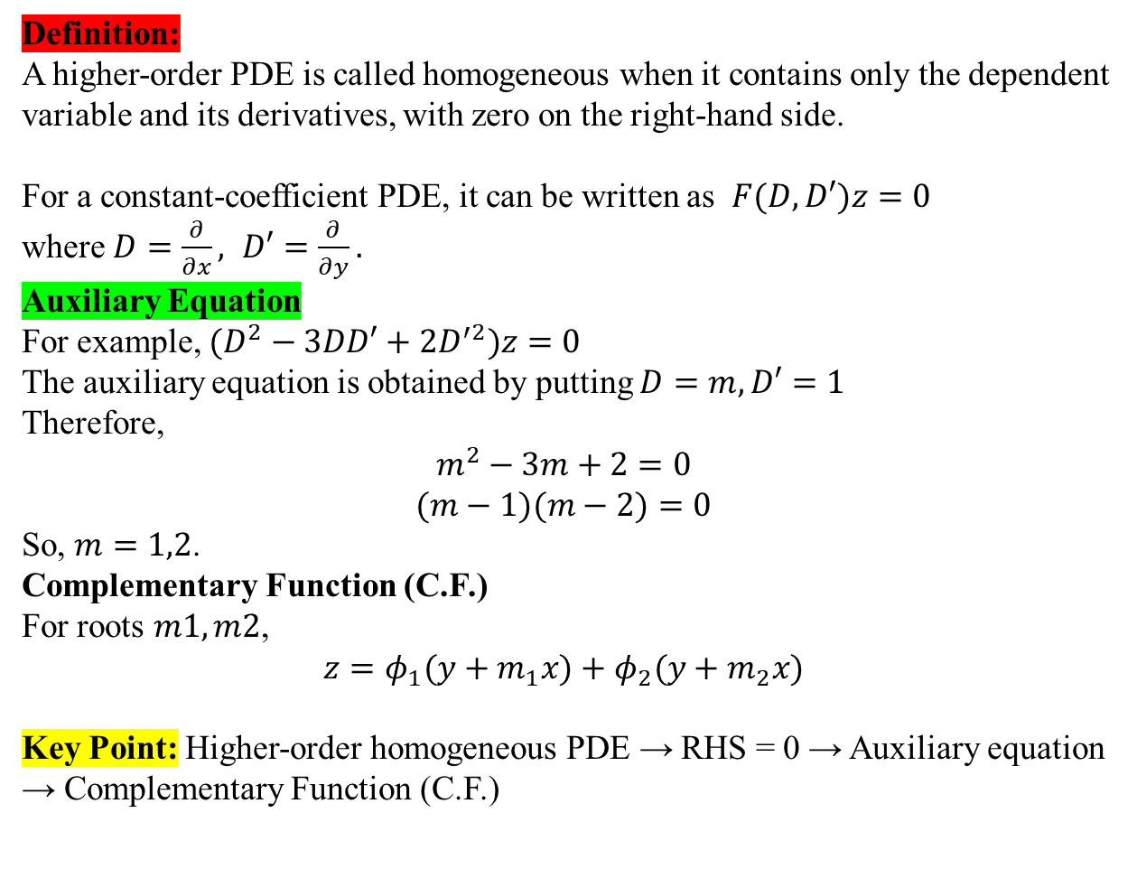
Higher-Order Homogeneous PDE
PART 08
Definition:
A higher-order PDE is called homogeneous when it contains only the dependent variable and its derivatives, with zero on the right-hand side.
For a constant-coefficient PDE, it can be written as $F(D,D′)z=0​$
where $D=\frac{∂}{∂x}​, D′=\frac{∂}{∂y}​.$
Auxiliary Equation
For example, $(D^{2}−3DD′+2D^{′2})z=0$
The auxiliary equation is obtained by putting $D=m, D′=1$
Therefore,
So, $m=1,2$.
Complementary Function (C.F.)
For roots $m1​,m2$​,
$$z=φ_{1}​(y+m_{1}​x)+φ_{2}​(y+m_{2}​x)​$$
Key Point: Higher-order homogeneous PDE → RHS = 0 → Auxiliary equation → Complementary Function (C.F.)
​
PART 07
PART 05
PART 06

Slide 12


Higher-Order Non-Homogeneous PDE
PART 11
Definition:
A higher-order PDE is called non-homogeneous when it has a non-zero function on the right-hand side.
For a constant-coefficient PDE: $F\left(D,D^{′}\right)z=f\left(x,y\right), f(x,y)≠0​$
Where $D=\frac{∂}{∂x}​, D′=\frac{∂}{∂y}​.$
General Solution
For a non-homogeneous PDE, $z=C.F.+P.I.​$
C.F.: C.F. is obtained by solving the corresponding homogeneous equation:
$$F(D,D′)z=0$$
P.I.: P.I. is obtained from
$P.I.=\frac{1}{F(D,D′)}​f(x,y)$​
Example: $\left(D^{2}−DD^{′}\right)z=e^{x+y}$
C.F.: $(D^{2}−DD′)z=0$
P.I.: P.I = $\frac{1}{D^{2}−DD′}e^{x+y}$
Therefore, $z=C.F.+P.I.​$
Key Point: Non-homogeneous higher-order PDE → C.F. + P.I.
where:
C.F. = Complementary Function
P.I. = Particular Integral
PART 10
PART 12
PART 09

Slide 13

Higher-Order PDE with Variable Coefficient / Cauchy–Euler Form
PART 12
Variable-Coefficient PDE
A higher-order PDE is called a variable-coefficient PDE when the coefficients of the derivatives are functions of the independent variables.
For example,
$$x^{2}z_{xx}​+y^{2}z_{yy}​+xyz_{xy}​=0$$
Here, the coefficients $x^{2},{;y}^{2},;xy$are variable.
Cauchy–Euler Form
A common type of variable-coefficient PDE is the Cauchy–Euler form, where the coefficients involve powers of the independent variables.
For example,
$$x^{2}z_{xx}​+2xyz_{xy}​+y^{2}z_{yy}​=0$$
Transformation
For Cauchy–Euler type equations, we commonly use $x=e^{X}, y=e^{Y}​$
or equivalently, $X=lnx, Y=lny​$
This transforms the variable-coefficient equation into a constant-coefficient PDE, which can then be solved using standard methods.
Key Point: Variable coefficients → Cauchy–Euler form → logarithmic transformation → constant-coefficient PDE
PART 11
PART 09
PART 10

Slide 14
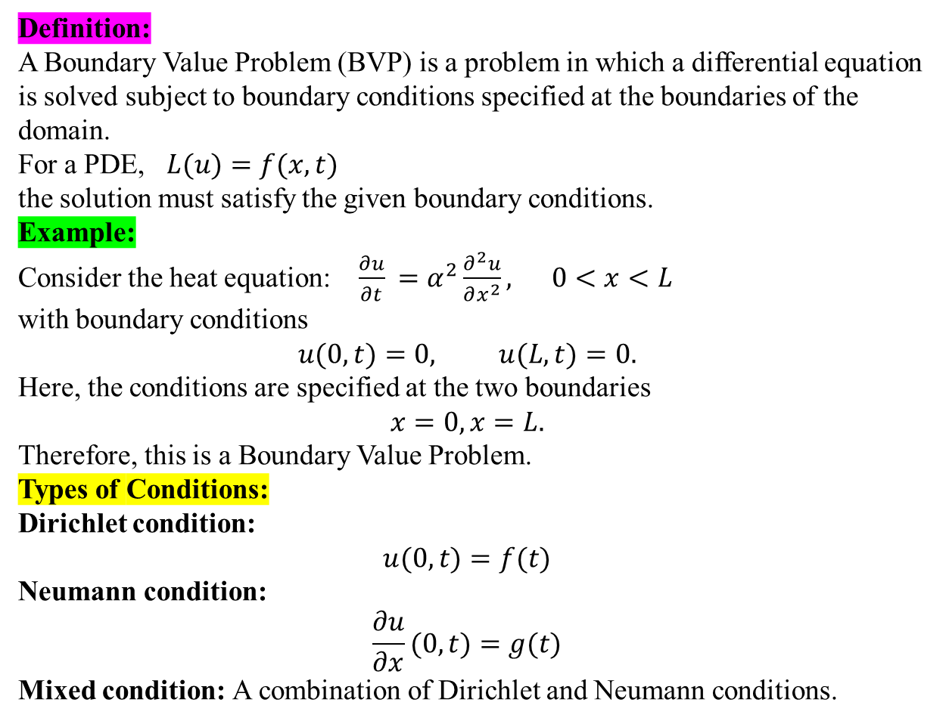
Boundary Value Problem (BVP)
PART 09
Definition:
A Boundary Value Problem (BVP) is a problem in which a differential equation is solved subject to boundary conditions specified at the boundaries of the domain.
For a PDE, $L(u)=f(x,t)​$
the solution must satisfy the given boundary conditions.
Example:
Consider the heat equation: $\frac{∂u}{∂t}​=α^{2}\frac{∂^{2}u}{∂x^{2}}​, 0<x<L$
with boundary conditions
$$u(0,t)=0, u(L,t)=0.$$
Here, the conditions are specified at the two boundaries
$$x=0,x=L.$$
Therefore, this is a Boundary Value Problem.
Types of Conditions:
Dirichlet condition:
$$u(0,t)=f(t)$$
Neumann condition:
$$\frac{∂u}{∂x}​(0,t)=g(t)$$
Mixed condition: A combination of Dirichlet and Neumann conditions.
PART 12
PART 10
PART 11

Slide 15

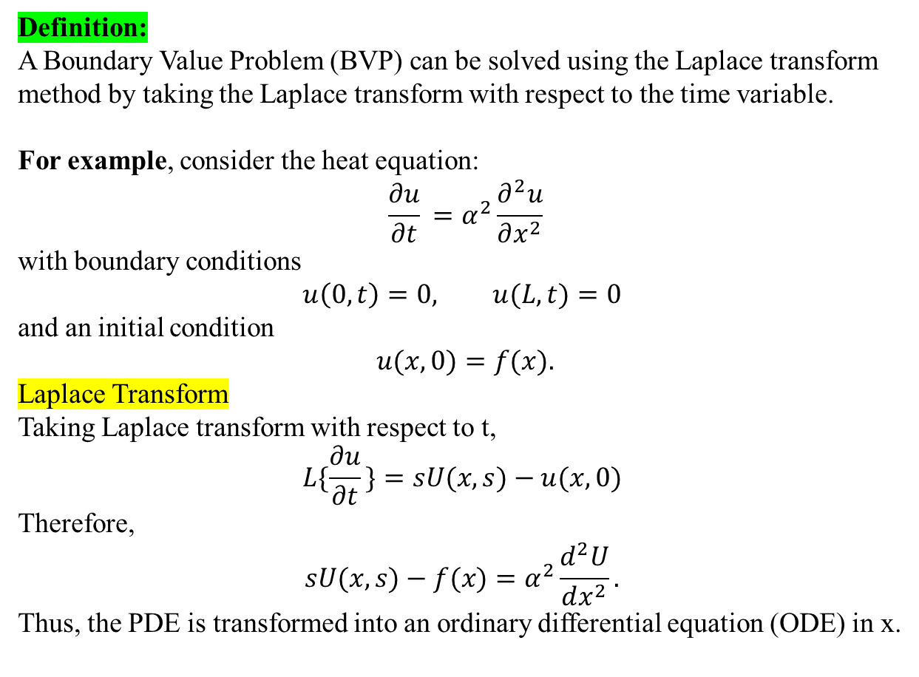
PART 12
Boundary Value Problem by Laplace Transform
Presenting By
Definition:
A Boundary Value Problem (BVP) can be solved using the Laplace transform method by taking the Laplace transform with respect to the time variable.
For example, consider the heat equation:
$$\frac{∂u}{∂t}​=α^{2}\frac{∂^{2}u​​}{∂x^{2}}$$
with boundary conditions
$$u\left(0,t\right)=0, u(L,t)=0$$
and an initial condition
$$u(x,0)=f(x).$$
Laplace Transform
Taking Laplace transform with respect to t,
$$L\{\frac{∂u}{∂t}​\}=sU(x,s)−u(x,0)$$
Therefore,
$$sU(x,s)−f(x)=α^{2}\frac{d^{2}U}{dx^{2}}​.$$
Thus, the PDE is transformed into an ordinary differential equation (ODE) in x.
PART 11
PART 09
PART 10

Slide 16


Slide 17


